Slide 1
CITY CONNECT CAR LOAN PROCESSING SYSTEMS

Slide 2

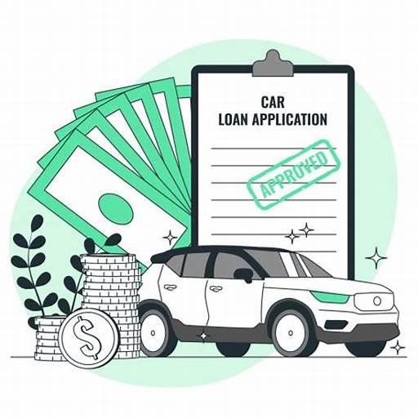
CONTENTS
INTRODUCTION
REQUIREMENT ANALYSIS
FLOW DIAGRAMS
PHASES

Slide 3
INTRODUCTION

Slide 4
The tasks involve loading applicant and car loan details into the bank's database, updating repayment details from collection agencies and CITY CONNECT Bank, and generating daily and weekly reports on car loan repayments. Additionally, there is a task for cleaning up and loading applicant, car loan, and payment data into the history database.

Slide 5
REQUIREMENT ANALYSIS

Slide 6
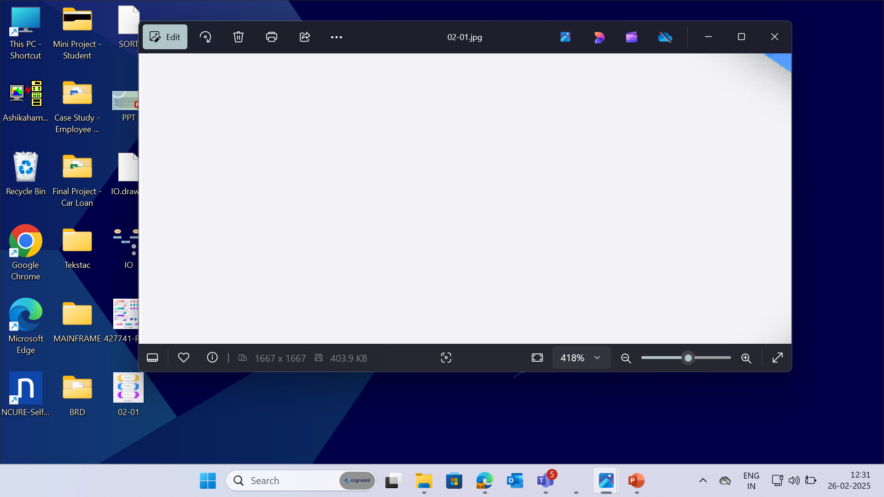


PCOMM Emulator - to access the Mainframe environment.
Pcom Emulator
SOFTWARE
REQUIREMENTS
DB2 - used for storing
the data in format.
TSO, JCL – to run and execute programs.
COBOL – to access inputs and perform required computations.
6
© 2025–2027 Cognizant | Private

Slide 7
CONTEXT FLOW DIAGRAM

Slide 8
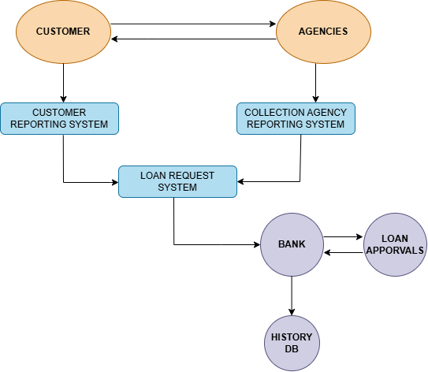
The context flow diagram shows loading applicant and car loan details, updating repayment information, generating repayment reports and cleaning/loading data into the history database.

Slide 9
DATA FLOW DIAGRAM

Slide 10
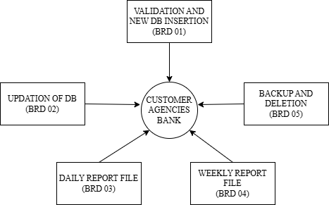
The Data Flow Diagram (DFD) visually represents the flow of data within a system, illustrating how data is processed.

Slide 11
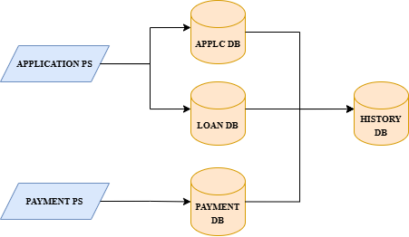
The below Flow Diagram depicts the overall process done in Car Loan Processing systems.

Slide 12
BUSINESS REQUIREMENT OVERIEW

Slide 13
BRD 04 - ASHIK AHAMED H
(2372596)

Slide 14
BRD : 04 - Weekly Report of Received Repayments
The process involves verifying if customer payments are made at least a week early compared to the next repayment due date and generating a weekly report in CSV format. It includes calculating discounts based on how early payments are made and updating the current balance amount accordingly. The records from CSV are then sorted into a file by given criteria. Then, those sorted records are backed up in a GDG file. Finally, details of applicants with current balances less than 30,000 are extracted and reported in the standard format with page breaks.

Slide 15
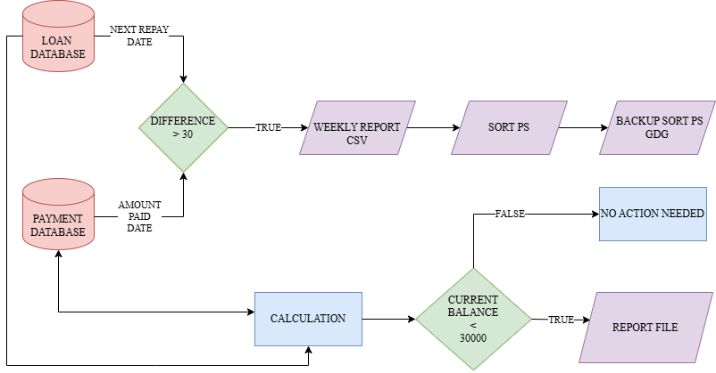
BRD : 04 – Flow Chart

Slide 16
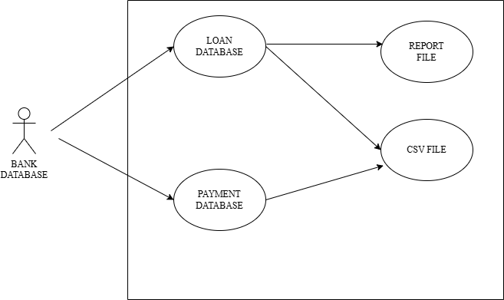
BRD : 04 – Use Case Diagram

Slide 17
PROCESS FLOW
Checking Early Payments
For each payment made, verify if it was done a week earlier than the next repayment due date, and report these details in a weekly CSV file to track early payments efficiently.
2. Calculating Discounts
Using subroutines, calculate the period between the current date and the repayment day for early payments, and apply discounts based on the number of days early. Update the payment database with the recalculated current balance amount.
3. Sorting and Backing Up Records
Sort the payment records by loan type, applicant ID, loan ID, and due date using the SORT utility, ensuring header and trailer records remain unchanged. Backup the sorted report in a GDG file with a limit of 10 versions for data security.

Slide 18
4. Performing Operations on Records
Perform operations on applicant records to calculate periods and apply discounts, recalculate current balances, and update the payment detail file and database. This ensures accurate financial records and rewards early payments.
5. Generating Reports
Extract details of applicants with a current balance amount less than 30,000, and generate separate report files in the standard format with a maximum of 8 lines per page, ensuring clear and organized reporting.

Slide 19
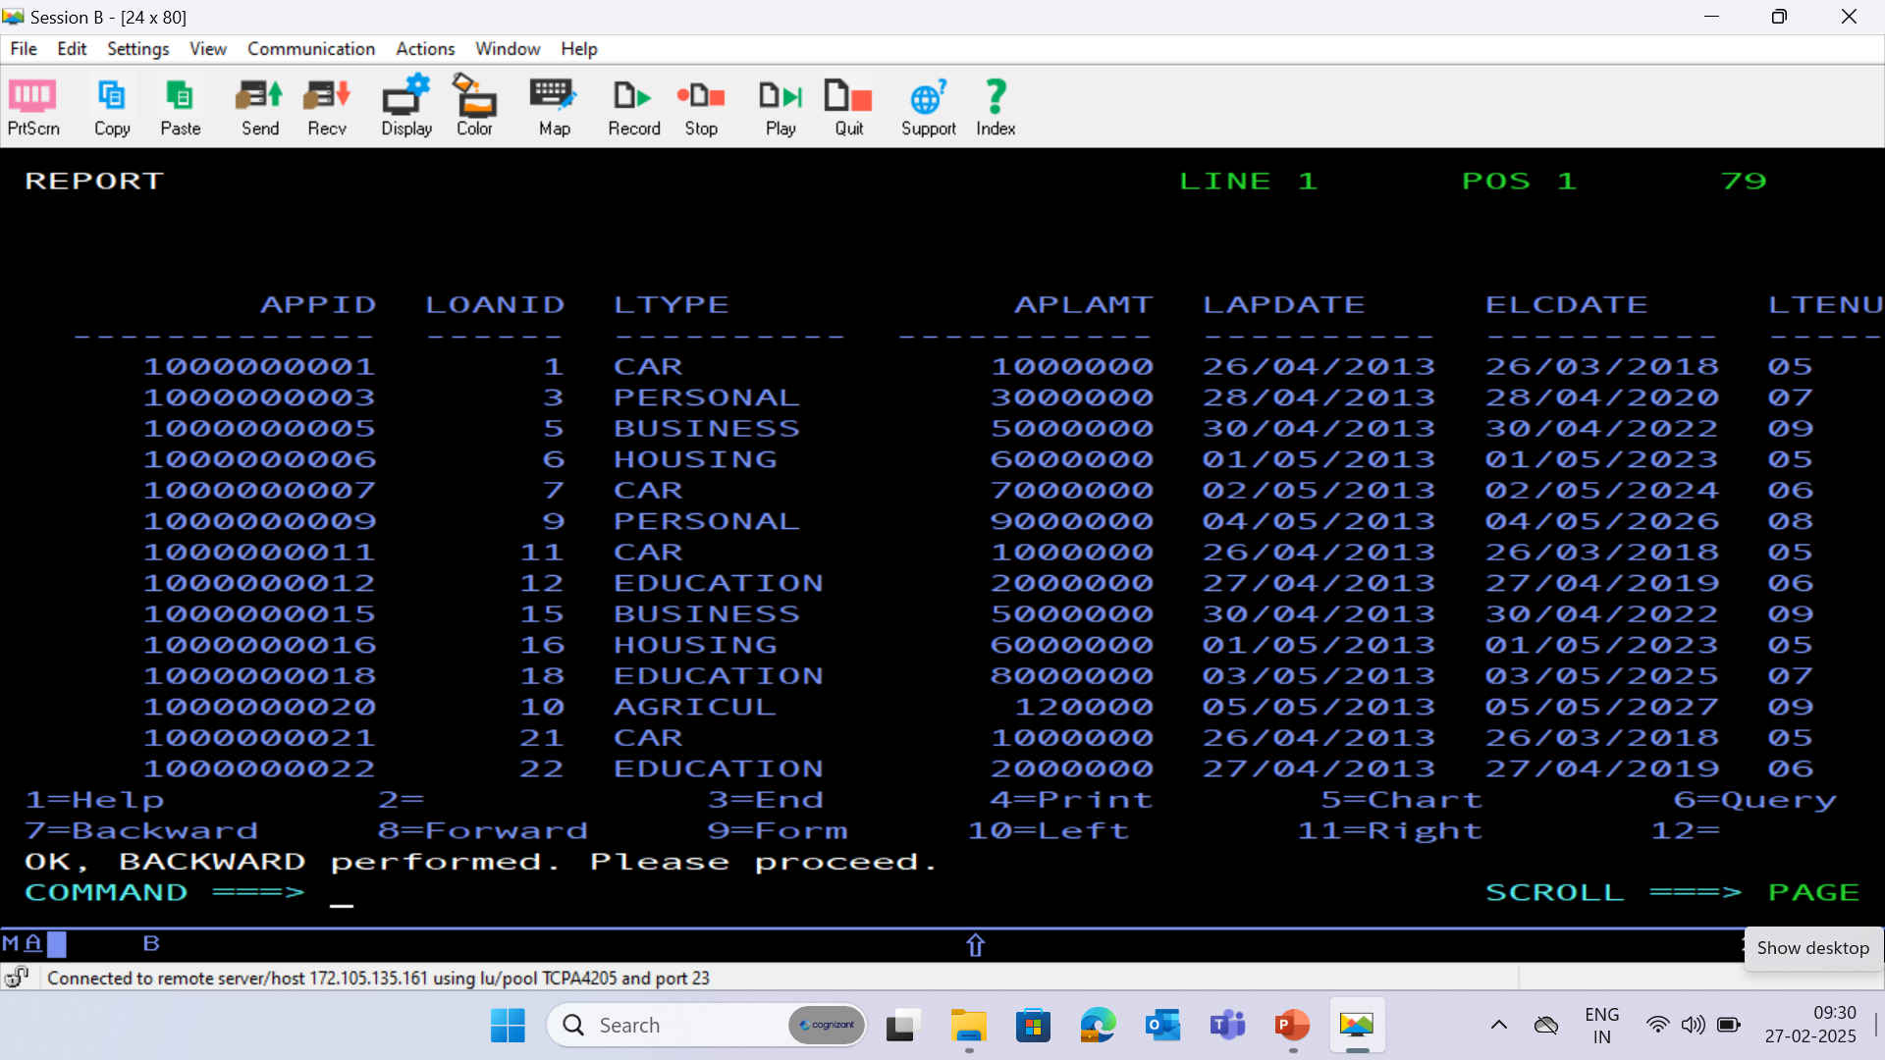
LOAN DATABASE - (LOAN)

Slide 20
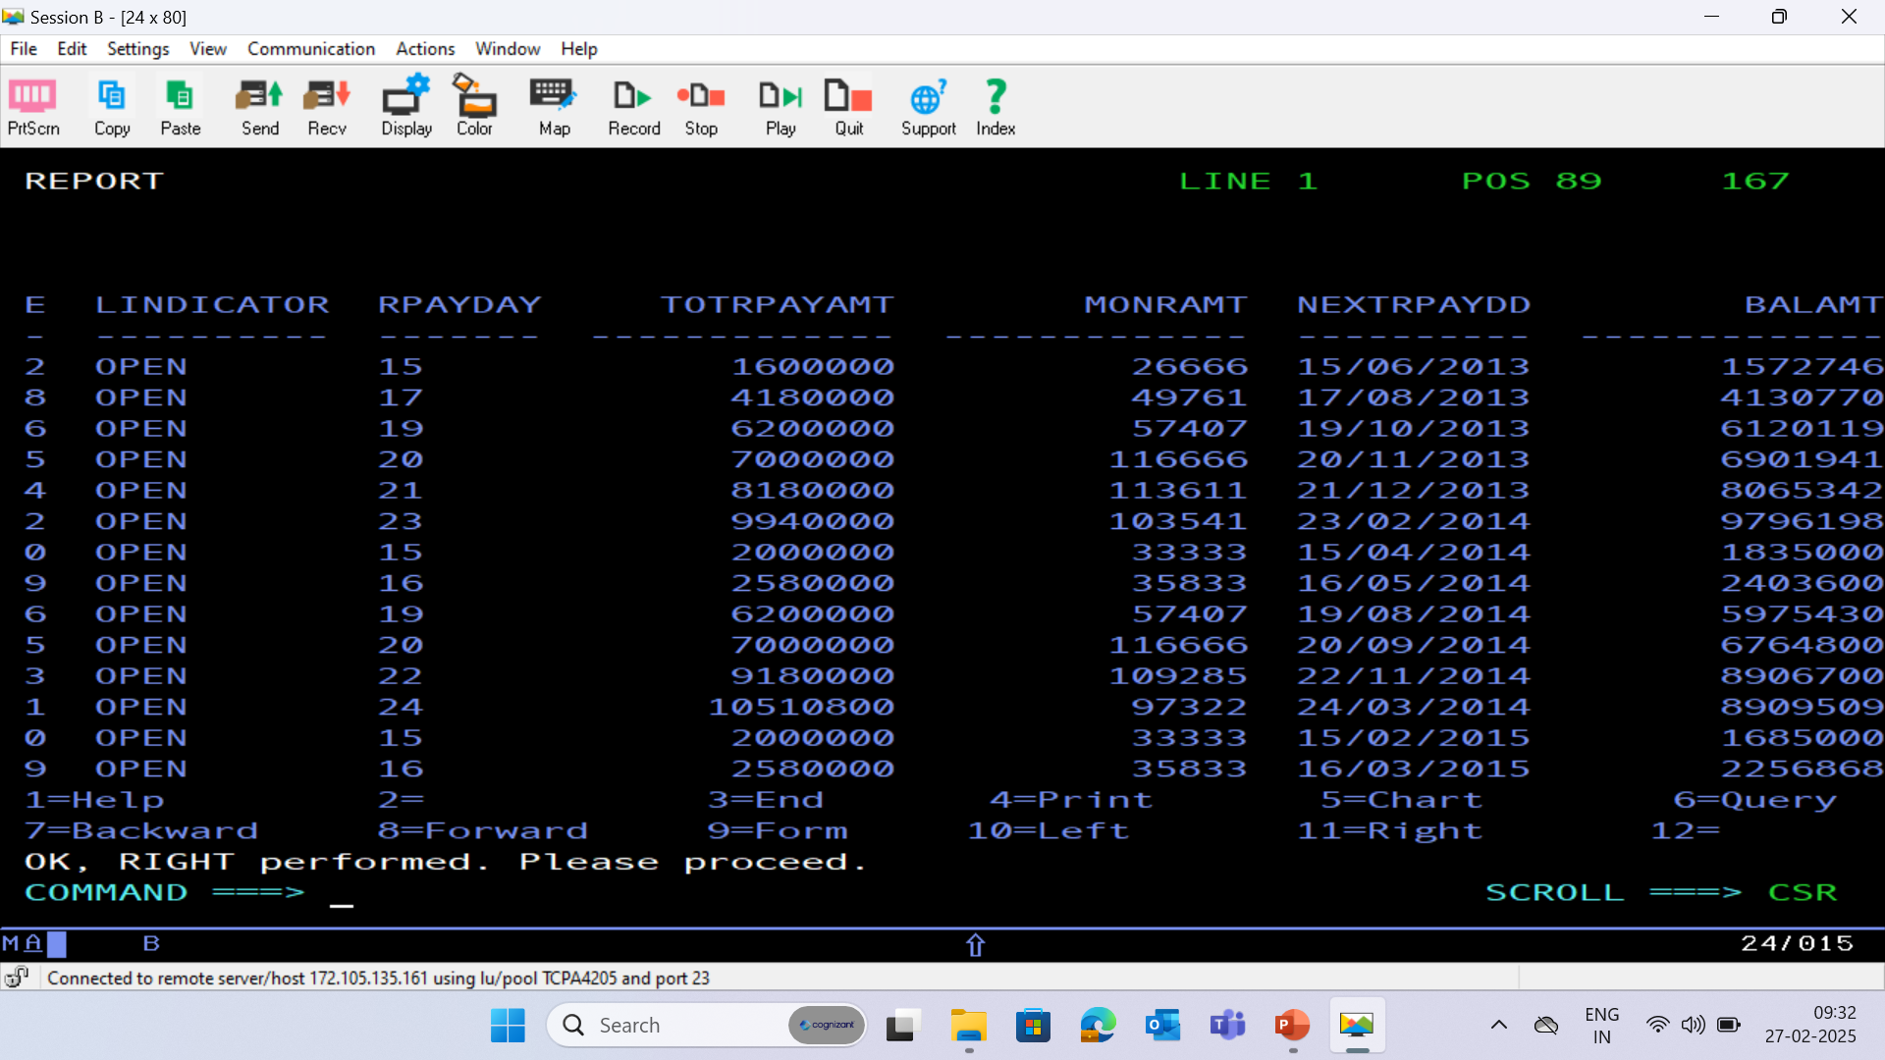

Slide 21
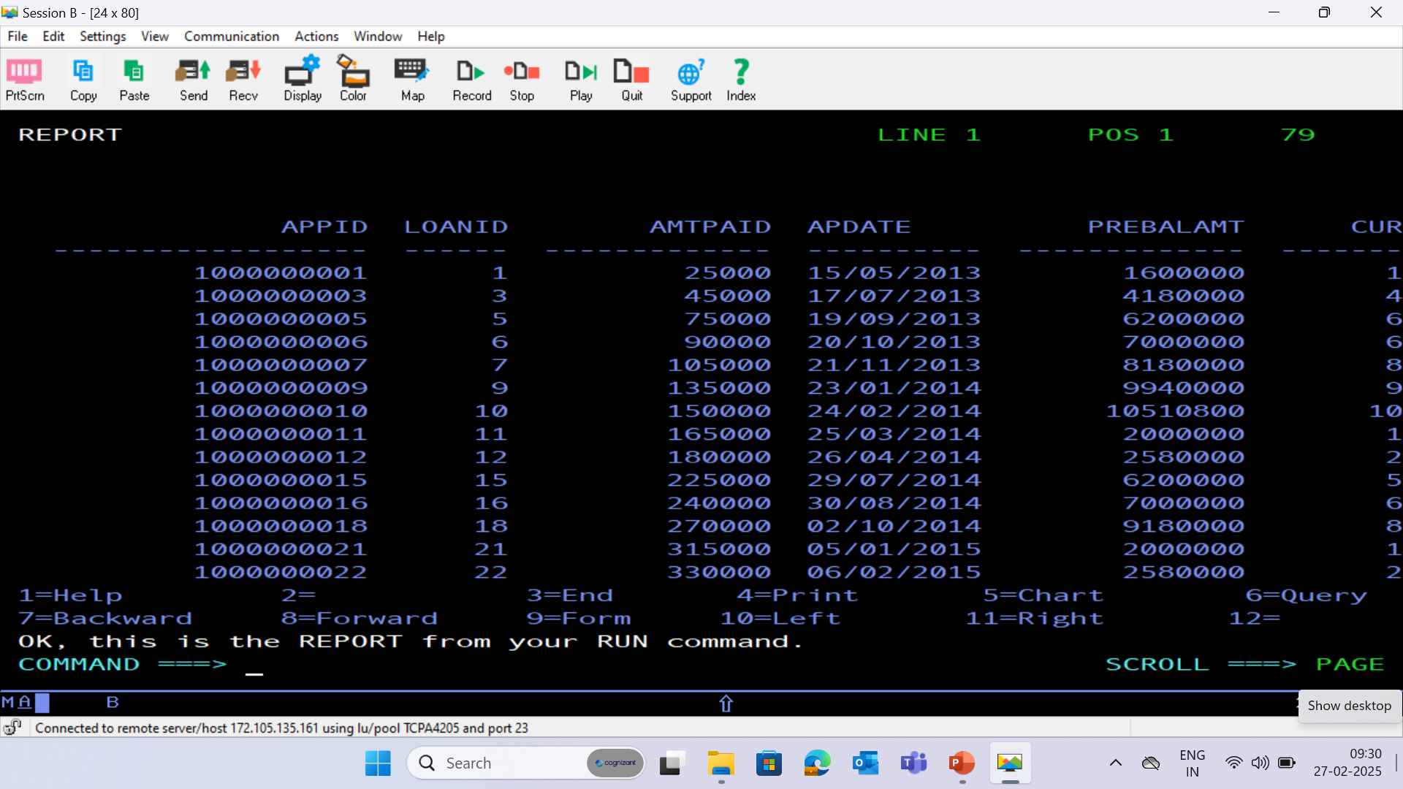
PAYMENT DATABASE - (PAYMENT)

Slide 22
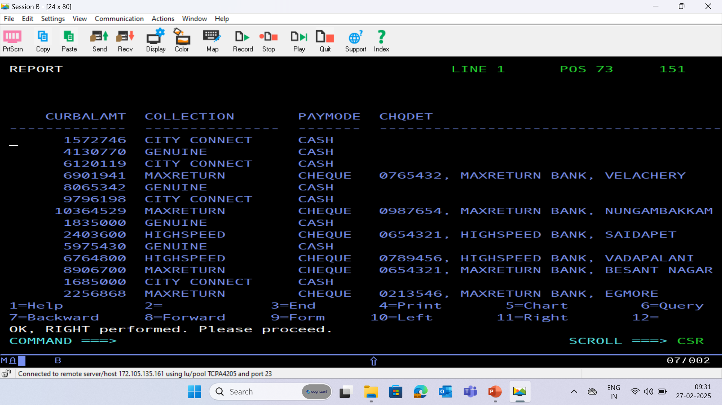

Slide 23
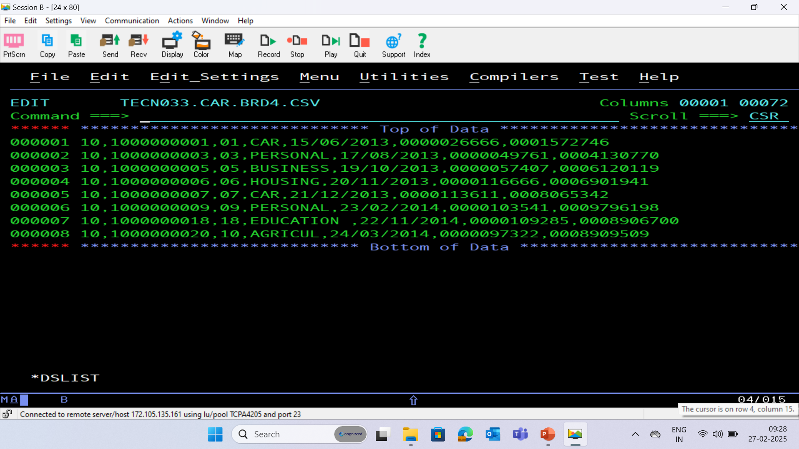
BRD 04 CSV (COMMA SEPERATED VALUES) FILE

Slide 24
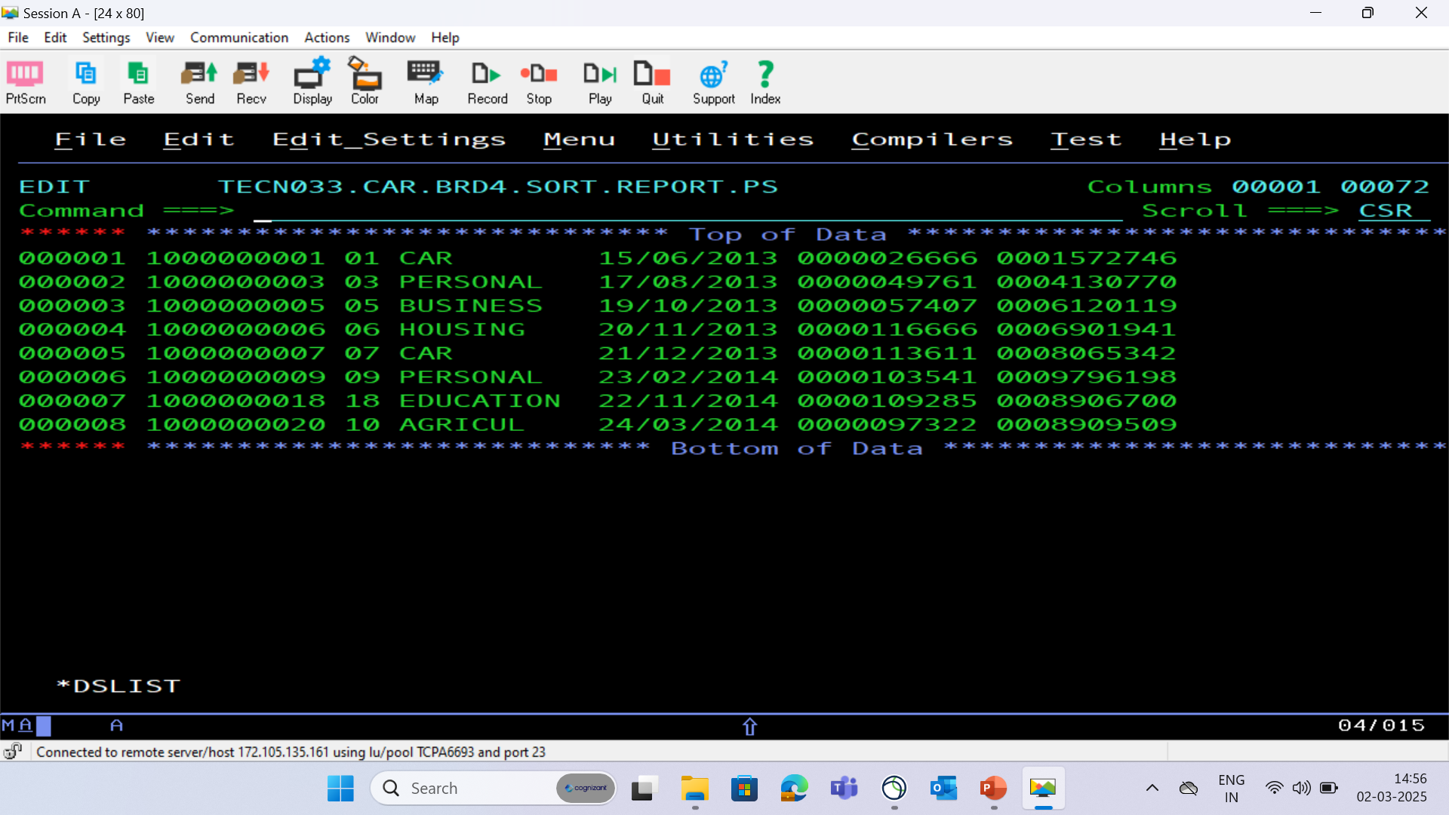
BRD 04 SORT FILE

Slide 25
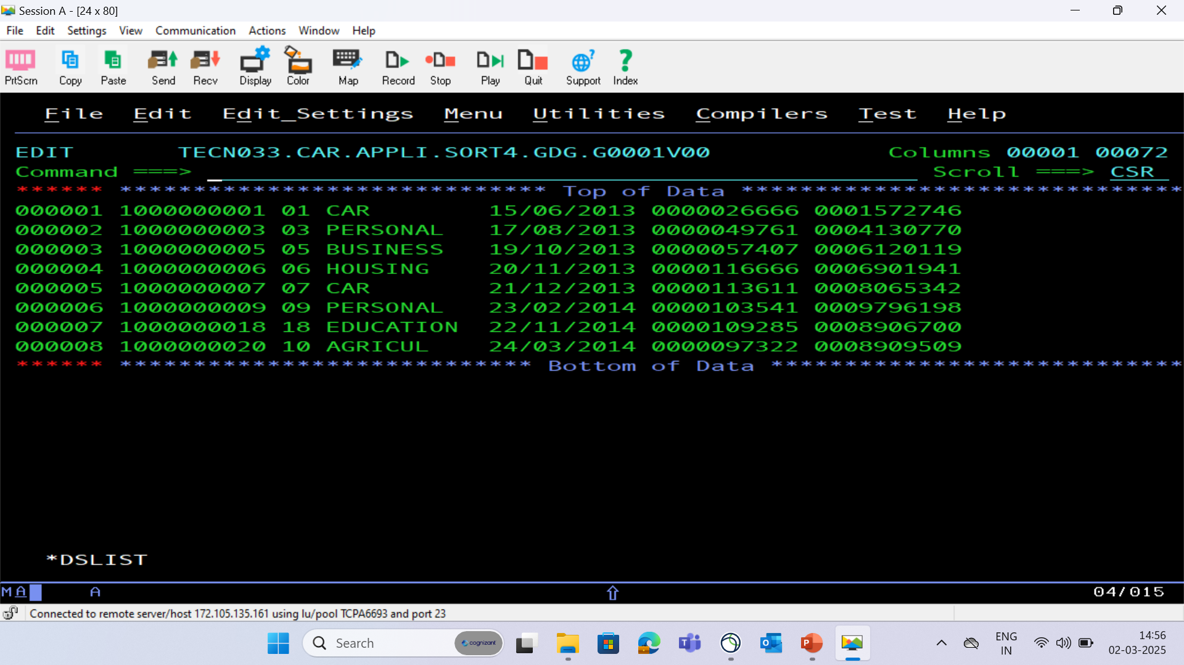
BRD 04 BACKUP SORT PS - GDG

Slide 26
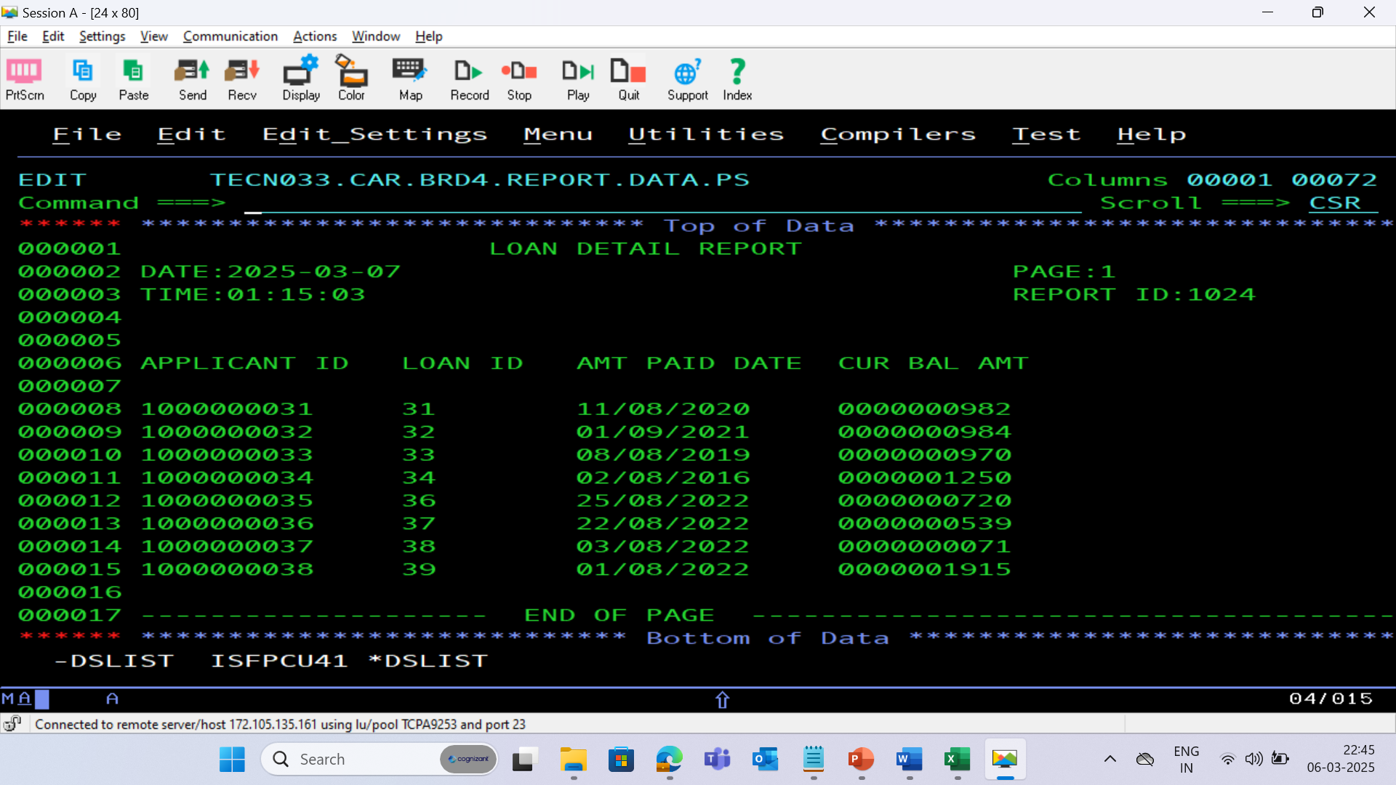
BRD 04 REPORT PS FILE

Slide 27
THANK YOU

